Slide 1


Career Growth & Development Employees

Slide 2
20 things in common

Slide 3
Reality check
Opportunity to improve skills seems to be a key driver for the outcome metric of Loyalty
Favorability scores in the Dimension of Our Growth and Our Dialogue has declined

Slide 4
New Career Reality

Slide 5
What does career mean to you?

Slide 6
Career means……
A journey of
POSSIBILITIES
Mastering and Succeeding in your current role
A succession of opportunities to increase Breath and Depth of experience
A road to the future and roles it brings
dramatic shifts in technology, society and global economics ARE re-defining work and re-shaping careers
Notes:
Click and the reality is…….

Slide 7



CAREER 'RULES' HAVE CHANGED
NEW RULES
The idea of a
single, Hierarchal Career
IS
no longer reality
Career development means upward progression
New positions are offered to me
My manager mainly helps me plan my career
Career Ladder
Taking on a new assignment can be risky
It takes a long time to become a senior leader
Career opportunities mean NEW experiences
I SEEK out and FIND new opportunities
I FIND new opportunities to constantly grow in my career
Career Lattice
Gathering critical experiences is the KEY to moving forward
Leadership is offered ALL the time
OLD RULES

Slide 8
TODAY’s CAREERS ARE GROWTH BASED
effective careers today are built around GROWTH Not positions
Careers Traditionally Designed Around Positions
Aspiration: Functional Leader
Functional Leader | Functional Leader | Functional Leader
Project Manager | Consultant | Project Manager
Project Lead | Business Analyst | Lead Consultant
Senior Associate | Junior Business Analyst | Senior Technical Consultant
Junior Associate | Business Associate | Junior Technical Consultant
Critical Experiences
Profit margin calculation
Preparation of project risk assessment
Leading key customer relationship
Opportunities for Gaining Them
New business development role
Finance and economics modules
Operational or audit role
Shadowing a current risk assessor
Commercial role
Mentoring by commercial leader
Leadership Capability
8

Slide 9

CAREER MOVEMENTS
A career path likely will include moves OTHER than vertical:
Enrichment: Growing in place
Exploratory: Investigating possibilities
Realignment: Re-contracted assignment
Relocation: Opportunity in other geographical area
Lateral: Moving across functions/roles/businesses

Slide 10
AFG Career Growth Model

Slide 11
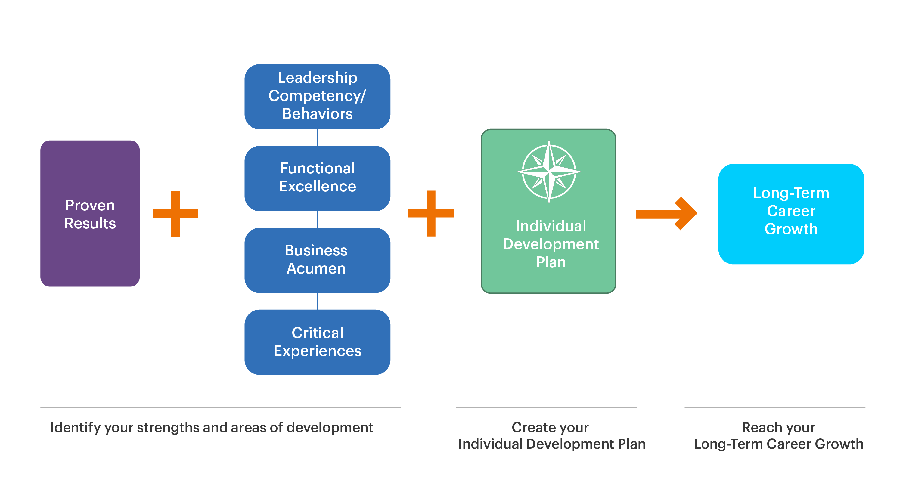
AL FUTTAIM CAREER GROWTH MODEL

Slide 12

PROVEN RESULTS
Demonstrating consistent and superior results is essential for consideration for new opportunities
Demonstrating consistent performance rating for at least 2 cycles
Understanding that Business growth drives personal growth
Understanding that it’s unlikely that one success will make a career or that one failure will end it
Acknowledging that it's not only important to achieve results, but also how results are achieved
Maintaining primary focus on achieving your current role’s objectives.
Notes:
Review your PMP evaluation and identify areas of opportunity.
Seek feedback throughout the year through CPM to ensure you are on track on you goals & development plans

Slide 13
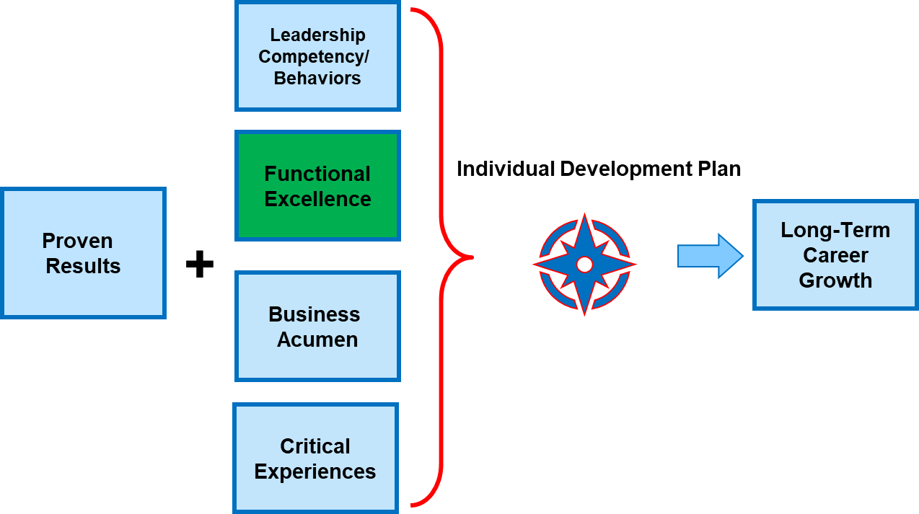

FUNCTIONAL EXCELLENCE
Demonstrating technical mastery of current role and driving continuous improvement
Notes:
Check functional skills inventories and frameworks (Functional Competencies if available)
Ask your manager on what you need to do to gain functional excellence
Stay current in your field/function
Leverage Self-directed learning
Seek feedback, and self reflect.
Understand what comes easy and gets you passionate in your work, these are probably your strengths.
Understand how you can leverage those strengths further, potentially in different areas of your role.
Understand what are the areas that you tend to struggle in, seek guidance on how to close the gap.

Slide 14
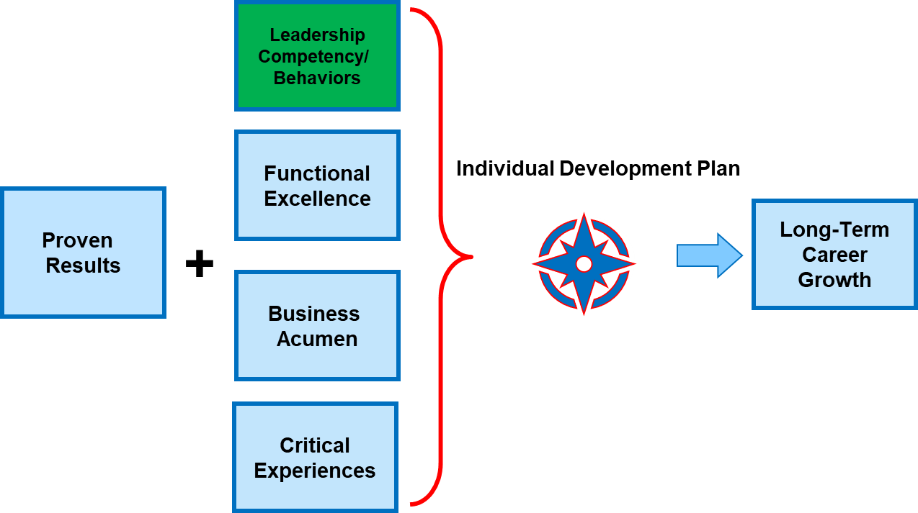
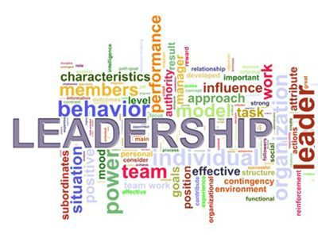
LEADERSHIP COMPETENCY/ BEHAVIOURS
You need to understand the leadership competencies/Behaviors & ask your self what are your areas of strength & what are your areas of development?
You need to discuss this with your manager to be able to understand what you need to focus on
You can leverage the 360 tool to provide you with a unique opportunity to gain insight on how your Leadership behaviors are being demonstrated and perceived.

Slide 15

BUSNIESS ACUMEN
Having a broader knowledge of the business in order to see the big picture.
Understanding key business drivers and financial indicators for success.
Knowing your own division, as well as others.
Understand what is driving the business growth today & what are the external factors that are impacting the business both positively or negatively.
Know what are the key strategic levers we are driving and how am I contributing to this
Notes:
Explore roles in others parts of the business!
Ask your manager to join cross-functional sessions projects/trainings.
Check out business & division / team websites, including LinkedIn Learning
Learn about the key drivers of our business and keep track of them.

Slide 16
CRITICAL EXPERIENCE
Many career journeys involve unexpected turns. That’s why your growth is not only about changing roles. It’s also about gaining a diverse set of critical experiences that fuel your career and make you more agile and able to take on new opportunities.
A CRITICAL EXPERIENCE IS:
A way to develop and refine your capabilities
Aspirational for future needs/strategy
An enabler of career growth throughout the organization
Based on knowledge of what’s required to move the business forward
Immersive - gained day to day (“on-the-job”)
Able to be duplicated - experiences multiple people can have (e.g., sectors, geography, category, etc.)
Challenging & tough to be able to reach your goals (e.g Hardship assignment)

Slide 17
Individual Development plan The How

Slide 18
30
58
9
25
53
6
46
2
17
57
49
10
54
1
33
22
38
41
37
50
45
18
13
29
21
34
26
5
14
42
4
52
55
11
32
12
3
35
56
48
16
27
44
40
39
19
20
60
15
43
51
31
24
28
8
47
36
59
7
23
Notes:
.

Slide 19
30
58
9
25
53
6
46
2
17
57
49
10
54
1
33
22
38
41
37
50
45
18
13
29
21
34
26
5
14
42
4
52
55
11
32
12
3
35
56
48
16
27
44
40
39
19
20
60
15
43
51
31
24
28
8
47
36
59
7
23

Slide 20

WHAT IS AN IDP
Individual Development Plan (IDP) is a tool to organize and target your development needs.
Its primary focus is to help you strengthen your current job performance and achieve short to long term career goals through a structured, well-rounded approach.
It can include a combination of interventions, such as experiential on the job learning, social learning through others and/or classroom/eLearning which is aligned with your line manager during your Career Conversation

Slide 21
WHY DO YOU NEED AN IDP
Lays out the employee career ambition and objectives and the path to take towards achieving them.
Aligns employee career aspirations with business needs and strategy
Ensures that the employee is continuously provided with the opportunity to learn and stretch within a continuously changing business needs
Sets up clear expectations between the employee and the manager
Increases Employee engagement and retention.

Slide 22
The How

Slide 23
WHAT I WANT VS WHAT I AM?
Motivation
Aspiration
Honest Career Conversation
Self-awareness
Notes:
Activity # 1- 15 min
Open the pre – Career Conversation Reflection. Think of what are your career Aspiration, Self-awareness & motivation. Answer the question under each one in order to be able to understand more about what you want.
Discussion
Each one will share some of the answers they captured and share their reflections after they answered the questions.

Slide 24
BUILDING YOUR DEVELOPMENT PLAN
Building a development plan is a shared responsibility between the employee & his/her line manager, where the employee is in the driver seat & the manager enables, facilitates and supports the execution of the plan
Asses where the learning needs to happen (current or future role).
Understand the current Strengths and Areas for Development through:
Feedback received from different stakeholders (manager, peers, customers etc.)
Technical (where present) & Leadership Competencies
Performance Evaluation/ 360 feedback/ additional assessments including external
Job Description
Understand How you learn Best
By Doing
By Observing others
By Understanding the theory
Match learning needs to learning interventions.
Keep in mind that an IDP is not only about addressing development needs, it is also about strengthening and leveraging current strengths
Notes:
Understand how you are doing today vrs expectations of your role, what is your ambition, understand what this means in terms of new technical capabilities, behaviors, mindset, experiences. Use these reflection points to drive a conversation with your line manager, gain alignment on what to focus on, discuss ways to address those learning needs keeping 70:20:10 and your learning style in mind.

Slide 25
JOB SPECFIC SKILL
Sales | Marketing | Finance
CRM Sales Force Inventory management | Copywriting Digital Media Content Creation | CPA CMA IBM Cognos Controller
HR | IT | Legal
Job Evaluation CBI Labor law | ERP Systems Java Script CSS | Employment Law Legal Writing Appeals

Slide 26
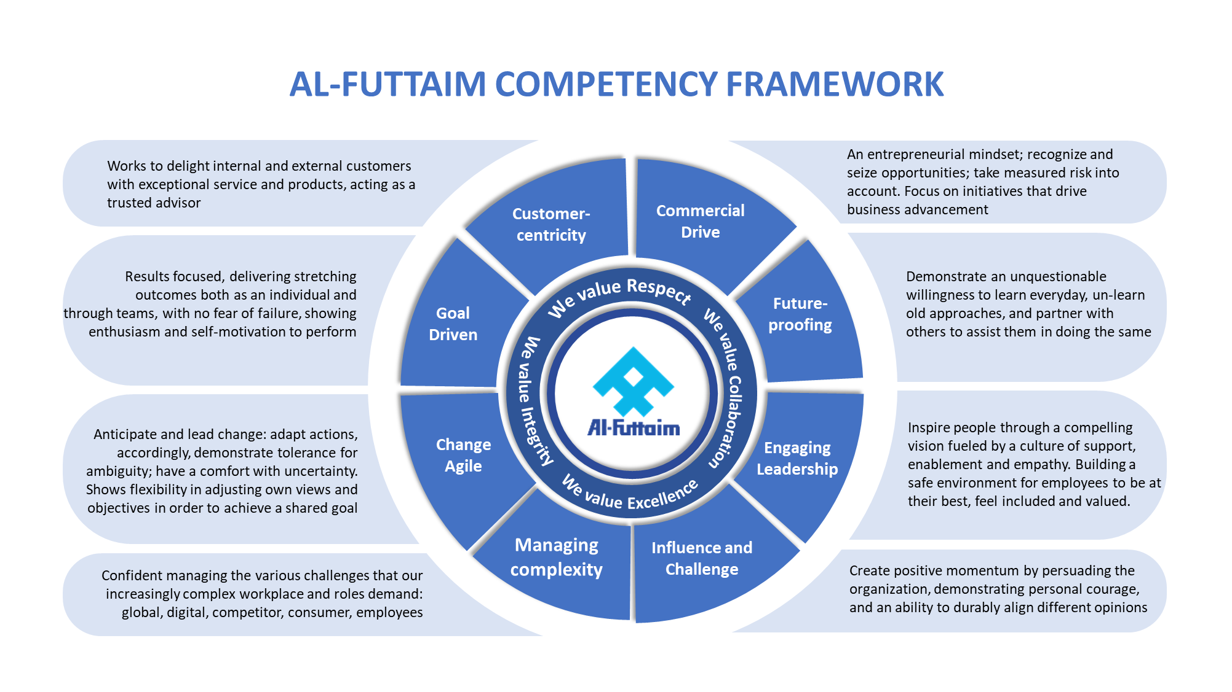
LEADERSHIP COMPETENCIES

Slide 27
AL FUTTAIM CAREER GROWTH MODEL
Identify strengths & gaps

Slide 28
Identify the Gaps
Building a development plan is a shared responsibility between the employee & his/her line manager, where the employee is in the driver seat & the manager enables, facilitates and supports the execution of the plan
MY AREAS OF STRENGTH | MY AREAS OF DEVELOPMENT
Notes:
Activity # 2- 15 min
On the IDP workbook Page 1 start assessing yourself on where you are and where are you going to help you in building your development plan
Discussion
Each one will share some of the answers they captured and share their reflections after they answered the questions.

Slide 29
Development Areas
My Development Areas
Notes:
Activity # 2 – 10 min
Based on the reflection points & feedback you wrote down in the previous activity, what are the development areas you wish to focus on. Prioritize 2-3 development areas.
Discussion
Ask some of the participants How many skills they already acquired. What are the steps they are taking to acquire those skills.

Slide 30
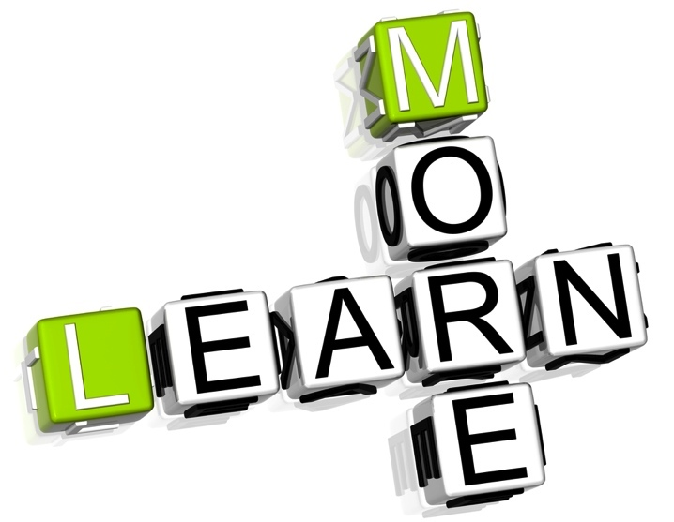
How you Learn BEST
As adults we all have a preferred way of learning, some learn best by doing, others by observing others do, and others prefer to understand the theory behind.
Whichever is your preferred style, it is important to do a bit of all three approaches to embed the learning.
However start your learning journey with the approach that comes easiest to you.

Slide 31
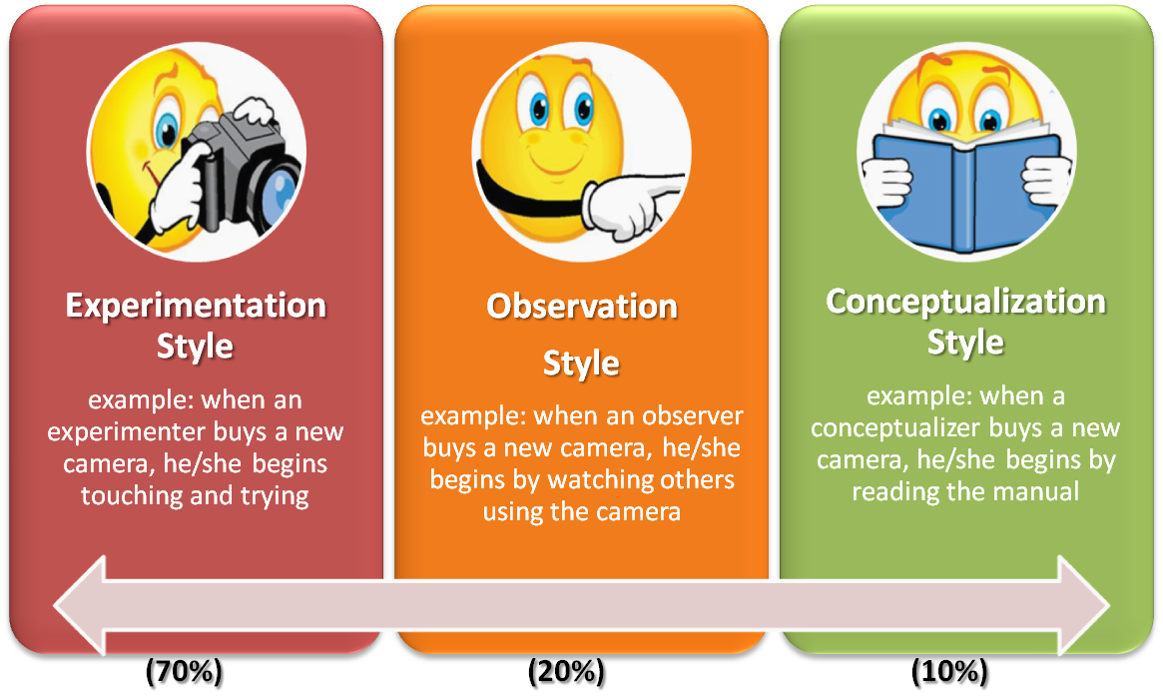
LEARNING STYLES

Slide 32
LEARNING APPROACH
The 70/20/10 learning approach is a widely used learning and development model which captures three types of learning: experiential, social and formal. The "70/20/10" ratios are an indication of the proportion of learning time someone might spend on each type of learning to get the most from their development. Whilst the proportions are only indicative, they are strongly embedded in adult learning theory.
70% - On the Job Learning
20% - Social Learning
10% - Classroom/e-Learning

Slide 33
What can I Do
70% - On the Job Learning
Secondments, stretched assignments or lateral moves to acquire skills and knowledge you wouldn’t get from working in your current role. Projects or participating on a working group within or outside your usual working area. These can give individuals the opportunity to develop new skills or work with other business areas Being a mentor or trainer around your area of expertise Job enlargement, taking on additional tasks that would not be part of your regular job scope. Double hatting, taking on an additional role beyond your own, and being exposed to new tasks Participating in level up strategic meetings
20% - Social Learning
Joining communities of practice or subject matter networks to enable learning through the experience of others Job shadowing - to learn about a different role, particular aspects of a role or work area and what it involves by observing the current role holder. Coaching – either from the line manager or other experienced coaches, supporting the employee to find their own solutions to challenges being faced. Being mentored by an expert in the particular area of interest. Conferences can be great places to build networks and understand how other people approach challenges you face
10% - Classroom/e-Learning
Workshops or other face to face courses: these may be external or internal to the division Webinars and Instructor led Virtual learning e.g. DriveIn/ LEAD Linkedin learning and other e-Learning modules available on iGrow Reading books/articles on relevant topics to stay up to date on the latest thinking.

Slide 34
70% - On the Job Training
Being part of/leading a project. Joining cross functional Project that will work together on building a dashboard. Request for opportunity to present during your team/department meetings Look for the opportunity to be part of a cross functional project
20% - Social Learning
Shadow a colleague who is strong in presenting through the whole process of structuring, developing and delivering Get mentored by business leader on ways to work in unstructured environment. Attend a peer learning circle and participate in the working groups. Job shadow the reporting & analyst specialist in your teams
10% - Classroom/e-Learning
Attend the Presentation skills training that is on drive in calendar Enroll in the reporting & analysis certificate. Read the leading change book for Kotter. Listen to Tedtalks about the importance of teamwork.
Notes:
Activity # 3 – 10 min
Use the IDP workbook page 3 & use the small Cards that we distributed.
Each Participant will have 4 development goals
You need to place the development card on the type of intervention that is relevant to your development goals
Development Goals:
I want to get better at presenting in public
I want to improve my ability to work in teams
I want to develop my analytical skills
I want to work on my ability to work in ambiguity & change
Discussion
Share what is your best learning approach & why

Slide 35
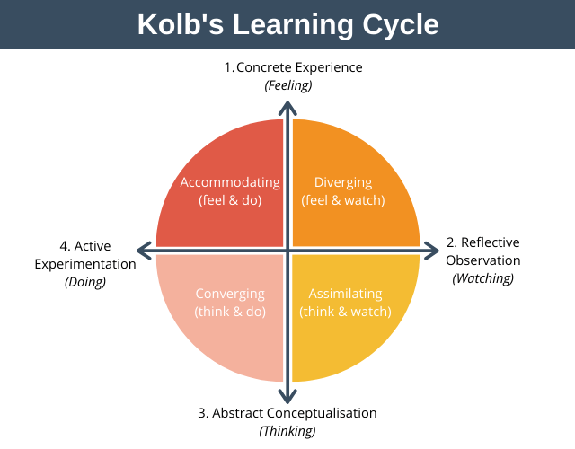
How you Learn BEST
As a learner you can enter the cycle at any point, however it is important to close the cycle by experiencing all four quadrants.

Slide 36
KEEP IN MIND that Development GOALS on IDP
Should be relevant to your individual performance and career aspirations and be realistic/attainable.
Should take stakeholder's feedback into consideration while crafting development goals.
Should concentrate on ways to leverage strengths as well as improve areas where you need development
Should be SMART – Specific, Measurable, Achievable, Realistic and Time bound.
Should apply the 70/20/10 rule, 70% of the development plan should be focused on on-the-job experiences, 20% on social such as mentoring & coaching, and 10% of formal classroom/computer-based training/e-learning.
Should Gain manager support to help you strengthen organization’s commitment to your development goals and also creates mutual accountability for achieving your development target.
36

Slide 37
INDIVIDUAL DEVELOPMENT PLAN EXAMPLES
Development Objective | Skills/knowledge & behaviour | Action steps/learning activity | Organizational/manager support | Success measures | Target Date Completion
Drive a culture of innovation in my team to enhance our customer centric approach | Innovation & Engagement | For the staff or teams you lead, set up monthly innovation sessions to discuss new ideas. Read about tools and techniques to facilitate design thinking sessions Solicit input from multiple sources, including your juniors, before making a decision. | Provide coaching on how to drive team innovation. | Engagement Survey (culture question) | July 2022

Slide 38
INDIVIDUAL DEVELOPMENT PLAN EXAMPLES
Development Objective | Skills/knowledge & behaviour | Action steps/learning activity | Organizational/manager support | Success measures | Target Date Completion
Notes:
Activity # 4 -10 min
Use the IDP workbook page 5 and fill in two of your IDP
Discussion
Share one goal and the other participants will judge if its SMART or not

Slide 39
Making it a GOOD Career Conversation
Accept feedback from you manager & be open to consider different perspectives in order to Progress & move forward.
Ask your manager who can support you with the development goals, such as :
Matrix manager
Mentor /A coach from within or outside the Division
Trusted peers
Subject matter expert/Senior Professional in the area you want to develop skills or a career
Stakeholders who can provide useful feedback on your strengths and areas for development
Have a balance of short-term goals with a longer-term ambition
Focus on Development rather than when is my next Promotion.
Make sure you understand all points discussed and align your manager to your IDP.
Update your IDP in IGrow and start moving towards your career goals TODAY
39

Slide 40
LONG–TERM CAREER GROWTH
Understanding how to build your own career is the foundation to reach your career aspiration & long-term career growth.
Careers are long-term in nature and the best ones evolve thoughtfully

Slide 41

TODAY’s CAREER SUCCESS
Own your journey – it’s your career
Know your purpose and values – they define your unique journey
Have a growth and development mindset – gather skills, experiences and expertise
Reinvent your professional self – as things change so must you
Be a lifelong learner
– it will bring lifelong employability
Leverage the tools – make sure you are ready
YOUR CAREER IS a JOURNEY NOT A DESTINATION

Slide 42
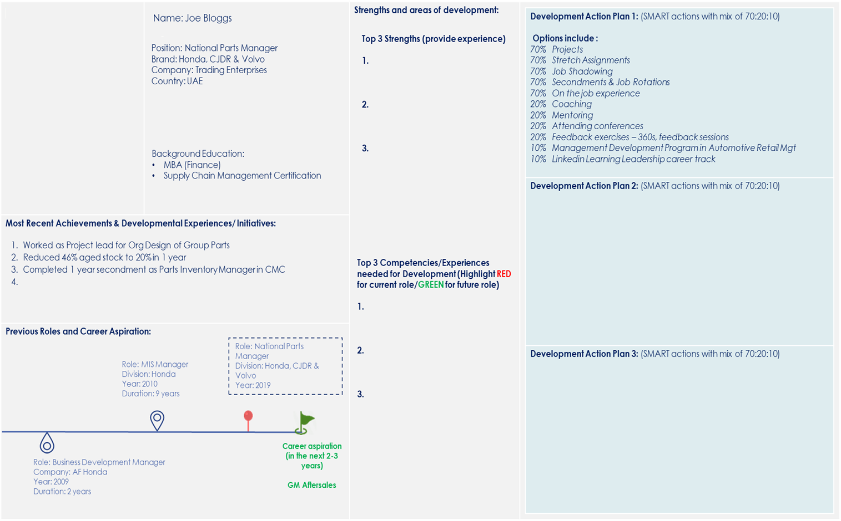
Career Growth & Development Template Example
IDPs available for all associates
2 types of IDP
1. Development in current role
Orange pin represents current role
2. Development towards future role
Green flag represents future role
70:20:10 development must be developed by the associate to ensure accountability of their own development – HRBPs and management support to enable opportunities for development through launched mechanisms

Slide 43
Talent Mgmt. Plan on a Page [POAP]
Completed
On Track
Slightly Delay/Issue
Significant Delay/Issue
On Hold
Plan on a Page [Milestones view]
Activity | 2023
 | Jan | Feb | Mar | Apr | May | Jun | Jul | Aug | Sep | Oct | Nov | Dec
Design product differentiator
Design process & operations standard
(Benchmark & Industry practice)
Build understanding from Sales & process by shadowing brand MD
Attend Electric Vehicle Innovation Summit
Sales and Service excellence program level 1
Implementation of marketing strategy, milestones, OKRs and KPIs
Milestone and KPIs progress feedback loops - Dec 2022 onward to SteerCo.
LinkedIn training– Global strategy and brand marketing integration
LinkedIn training– Digital strategy
Set up a directional objectives for the team cascaded from the brand initiatives
Coaching session with Line Manager on setting up the department vision
Coaching session with Line Manager on the launch of brand specific Digital Org structure
Meet my coach David Ross for my 1st meeting on how I can strategize my business goals
LinkedIn training: Transformational Leadership
LinkedIn training: Executive Leadership
LinkedIn training: Leadership mindset

Slide 44



Overview
Previous Roles and Career Aspirations
Job title
Head of Digital Marketing
XXXXXXX
XXXXXXX
XXXXXXX
XXXXXXX
Background Education
BA Business Administration Google & Facebook certified
Role: Advertising Specialist
Company: XXXXXX
Year: 2012
Duration: 2 years
Role: Digital Marketing Mgr. Company XXXXXXXX
Year: 2014
Duration: 2 years
Role: Digital Marketing Mgr. Company: XXXXXX
Year: 2020
Duration: 2 years
Age
Jack Antonio
Brand
Career aspiration (in the next 2-3 years)
Head of Performance Marketing
Company
Role: UX Team Lead
Company: XXXXXX
Year: 2008
Duration: 4 years
Role: SEO Mgr.
Company: XXXXX
Year: 2013
Duration: 1 year
Role: Digital Marketing Mgr.
Company: XXX
Year: 2017
Duration: 3 years
Country
Most Recent Achievements & Developmental Experiences/ Initiatives:
Completed
On Track
Slightly Delay/Issue
Significant Delay/Issue
On Hold
Plan on a Page [Milestones view]
Certified Agile Engagement Level 1 program.
Delivered digital project, ecommerce sites for XXX, XXX & XXXX
Introducing new digital platforms and opportunities (Social media, Omni channels, and programmatic) to XXXXXX.
Injecting digital mindset into all business channels of XXXX by acting SME
Activity | 2022
 | Jan | Feb | Mar | Apr | May | Jun | Jul | Aug | Sep | Oct | Nov | Dec
Activity 1
70%
Design product differentiator
Strength and Area of Development
Design process & operations standard
(Benchmark & Industry practice)
List top 3 Competencies needed for Development (Highlight RED for current role/GREEN for future role)
Auto Industry Awareness
Strategic Development
Executive Leadership
Provide top 3 Strengths (provide by experience)
1. Omi channels & Digitalization
Worked on 360 marketing projects
Online, instore and cross platforms digital experience
Track record of successful hybrid marketing performance campaigns.
2. Excellent Communication Skills
Active listening.
Friendly when dealing with others
Confident
Provide effective feedback.
Engaging and confident presenter
3. People Manager
Ability to lead teams to achieve specific targets and goals.
Excellent coaching and team development capabilities.
Can manage general marketing teams working in CRM, content, social media, SEO, SEM and Graphics.
20%
Build understanding from Sales & process by shadowing brand MD
Attend Electric Vehicle Innovation Summit
10%
Sales and Service excellence program level 1
Activity 2
70%
Implementation of marketing strategy, milestones, OKRs and KPIs
20%
Milestone and KPIs progress feedback loops - Dec 2022 onward to SteerCo.
10%
LinkedIn training– Global strategy and brand marketing integration
LinkedIn training– Digital strategy
Activity 3
70%
Set up a directional objectives for the team cascaded from the brand initiatives
20%
Coaching session with Line Manager on the launch of brand specific Digital Org structure
10%
LinkedIn training: Leadership mindset
LinkedIn training: Transformational Leadership
LinkedIn training: Executive Leadership

Slide 45


